Slide 1
Objectives
In this session, you will learn to:
  Use Windows project by using Visual Studio .NET integrated development environment
Notes:
Start the session by sharing the session objectives with the students.

Slide 2
Using Visual Studio .NET IDE
The Visual Studio .NET IDE provides you with a common interface for developing various kinds of applications.
The IDE also provides you with a centralized location for:
  Designing the user interface for an application.
  Writing code for the application.
  Compiling the application.
  Debugging the application.
Notes:
Using this slide discuss the .NET IDE with the students. An effective way of explaining the IDE to the students will be to open the .NET windows application project and discuss each of the components including:
Windows Form Designer
Code Window
Toolbox
Properties Window
Solution Explorer Window
Error-view Window
Output Window
And the menu and toolbars available within the IDE.
The faculty should also discuss the following templates in .NET:
Windows Application
Class Library
Windows Control Library
Console Application
Device Application
Crystal Reports Application

Slide 3
Creating Projects and Solutions
In Visual Studio .NET, an application can be made up of one or more items, such as files and folders.
To organize these items efficiently, Visual Studio .NET provides two types of containers:
  Projects
  Solutions
Notes:
Using this slide discuss the .NET IDE with the students. An effective way of explaining the IDE to the students will be to open the .NET windows application project and discuss each of the components including:
Windows Form Designer
Code Window
Toolbox
Properties Window
Solution Explorer Window
Error-view Window
Output Window
And the menu and toolbars available within the IDE.
The faculty should also discuss the following templates in .NET:
Windows Application
Class Library
Windows Control Library
Console Application
Device Application
Crystal Reports Application

Slide 4
Creating Projects and Solutions (Contd.)
  Project:
  It contains interrelated items that make up the application.
  It allows you to manage, build, and debug the items.
  An executable file (.exe) or a Dynamic Link Library (.dll) is created when you build a project. These files are called the project output.
  Solution:
  It acts as a container for one or more projects.
  It allows you to work on multiple projects within the same instance of the Visual Studio .NET IDE.
Notes:
Using this slide discuss the .NET IDE with the students. An effective way of explaining the IDE to the students will be to open the .NET windows application project and discuss each of the components including:
Windows Form Designer
Code Window
Toolbox
Properties Window
Solution Explorer Window
Error-view Window
Output Window
And the menu and toolbars available within the IDE.
The faculty should also discuss the following templates in .NET:
Windows Application
Class Library
Windows Control Library
Console Application
Device Application
Crystal Reports Application

Slide 5
Creating Projects and Solutions (Contd.)
The following figure shows a solution containing multiple projects.
Solution
Project 1
Items
Project 1
Project 2
Project 2
Items
Miscellaneous Files
Notes:
Using this slide discuss the .NET IDE with the students. An effective way of explaining the IDE to the students will be to open the .NET windows application project and discuss each of the components including:
Windows Form Designer
Code Window
Toolbox
Properties Window
Solution Explorer Window
Error-view Window
Output Window
And the menu and toolbars available within the IDE.
The faculty should also discuss the following templates in .NET:
Windows Application
Class Library
Windows Control Library
Console Application
Device Application
Crystal Reports Application

Slide 6

Creating Projects and Solutions (Contd.)
Let us see how to create a Windows application in Visual Studio .NET IDE.

Slide 7
Creating Projects and Solutions (Contd.)
The following table describes various templates available in the Templates pane.
Template | Description
Windows Application | It creates Windows-based application.
Class Library | It creates a class or a reusable component (.dll or .exe) that exposes some functionality to be used in various projects.
Windows Control Library | It creates a custom control that can be added to the user interface.
Console Application | It creates a CUI-based application that can run from the command prompt.
Device Application | It creates a .NET Compact Framework 2.0 forms application for Pocket PC 2003 and later.
Crystal Reports Application | It adds a Windows user interface and a sample crystal report in the .NET application.
Notes:
Using this slide, explain the values of the MdiLayout method for arranging child forms in several ways.

Slide 8
Just a minute
Which template creates a .NET Compact Framework 2.0 forms application for Pocket PC 2003 and later?
  1. Windows Control Library
  2. Class Library
  3. Device Application
  4. Web Control Library
Answer:
  3. Device Application
Notes:
Reiterate the concepts taught earlier by asking the given question.

Slide 9
Creating Projects and Solutions (Contd.)
Let us see various user interface elements of Visual Studio .NET IDE.

Slide 10
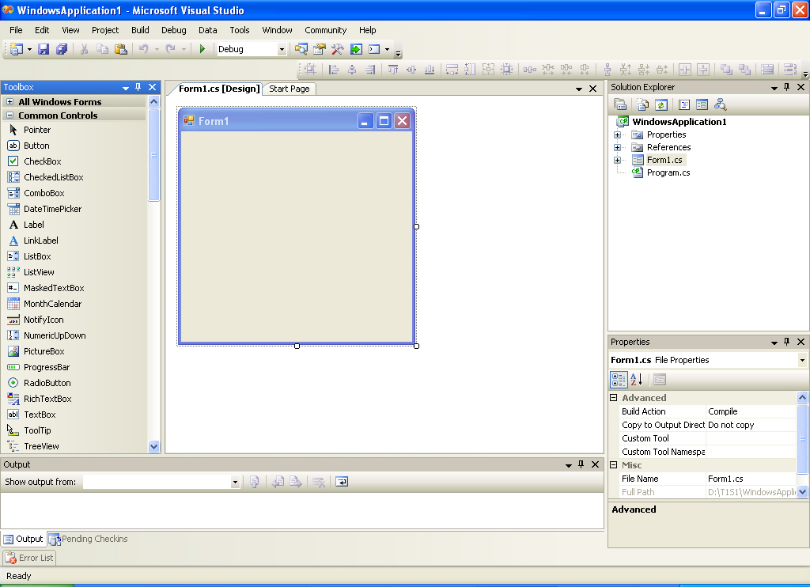
Creating Projects and Solutions (Contd.)
The following figure shows various interface elements of Visual Studio .NET IDE.
Menu Bar
Solution Explorer Window
Windows Form Designer
Toolbox Window
Properties Window
Output Window
Notes:
Using this slide discuss the .NET IDE with the students. An effective way of explaining the IDE to the students will be to open the .NET windows application project and discuss each of the components including:
Windows Form Designer
Code Window
Toolbox
Properties Window
Solution Explorer Window
Error-view Window
Output Window
And the menu and toolbars available within the IDE.
The faculty should also discuss the following templates in .NET:
Windows Application
Class Library
Windows Control Library
Console Application
Device Application
Crystal Reports Application

Slide 11
Creating Projects and Solutions (Contd.)
The following table describes various windows of Visual Studio .NET IDE.
Window Name | Description
Output Window | It displays messages regarding the status of various features provided in the Visual Studio. You can open it by selecting View→Output. Alternatively, you can use the key combination Ctrl+W, O.
Server Explorer Window | It is a tool used for various administrative tasks, such as monitoring the performance of other machines on a network, and locating and connecting to the various servers on the network. You can open it by selecting View→Server Explorer. Alternatively, you can use the key combination CTRL+W, L.
Class View Window | It displays the classes, methods, and properties associated with a particular file. You can open it by selecting View→Class View. Alternatively, you can use the key combination Ctrl+W, C.
Dynamic Help Window | It provides you with context-sensitive help. You can open the dynamic help window by selecting Help→Dynamic Help. Alternatively, you can use the key combination CTRL+F1, D.
Notes:
Using this slide, explain the values of the MdiLayout method for arranging child forms in several ways.

Slide 12
Just a minute
Which window displays messages for the status of various features provided in the Visual Studio .NET IDE?
Answer:
  The Output Window
Notes:
Reiterate the concepts taught earlier by asking the given question.

Slide 13
Just a minute
Which window allows to view the resources of the servers, such as services, processes, and the event log?
Answer:
  The Server Explorer window
Notes:
Reiterate the concepts taught earlier by asking the given question.

Slide 14
Navigational Features in Visual Studio .NET IDE
The three navigational features provided by Visual Studio .NET IDE are:
  Docking: Allows you to place a window against any of the edges of the parent window.
  Tabbed: Allows overlapping of various open windows and navigating between them by using tabs.
  Auto Hide: Automatically hides a window when it is not in use.
Notes:
While discussing the IDE, the faculty must also explain that .NET also provides three navigational features with almost all the windows. Demonstrate each of them for a better understanding of the features.

Slide 15
Navigational Features in Visual Studio .NET IDE (Contd.)
Let us see how to use various navigational features provided by the Visual Studio .NET IDE.

Slide 16
Compiling and Executing a Project
Let us see how to compile and execute an application.

Slide 17
Summary
In this session, you learned that:
  The Visual Studio 2005 IDE provides you with a common interface for developing various kinds of applications on the .NET Framework.
  Some of the components of the Visual Studio .NET IDE are:
    The Windows Forms Designer
    The Solution Explorer window
    The Properties window
    The Toolbox window
    The Output window
    The Code and Text Editor window
Notes:
You can summarize the session by using the summary given in the slides.
In addition, you can also ask students summarize what they have learnt in this session.

Slide 18
Summary (Contd.)
  The Visual Studio .NET IDE also provides three navigational features. These are:
    Docking
    Tabbed
    Auto hide

Slide 19
Home Assignment
Let me give you some questions to solve at home.

